Slide 1

CDAC ATC NETCOM JAIPUR
Project Guide
Mrs. Prajakta Mam
Mr. Bhanu Pratap Singh Sir

Slide 2
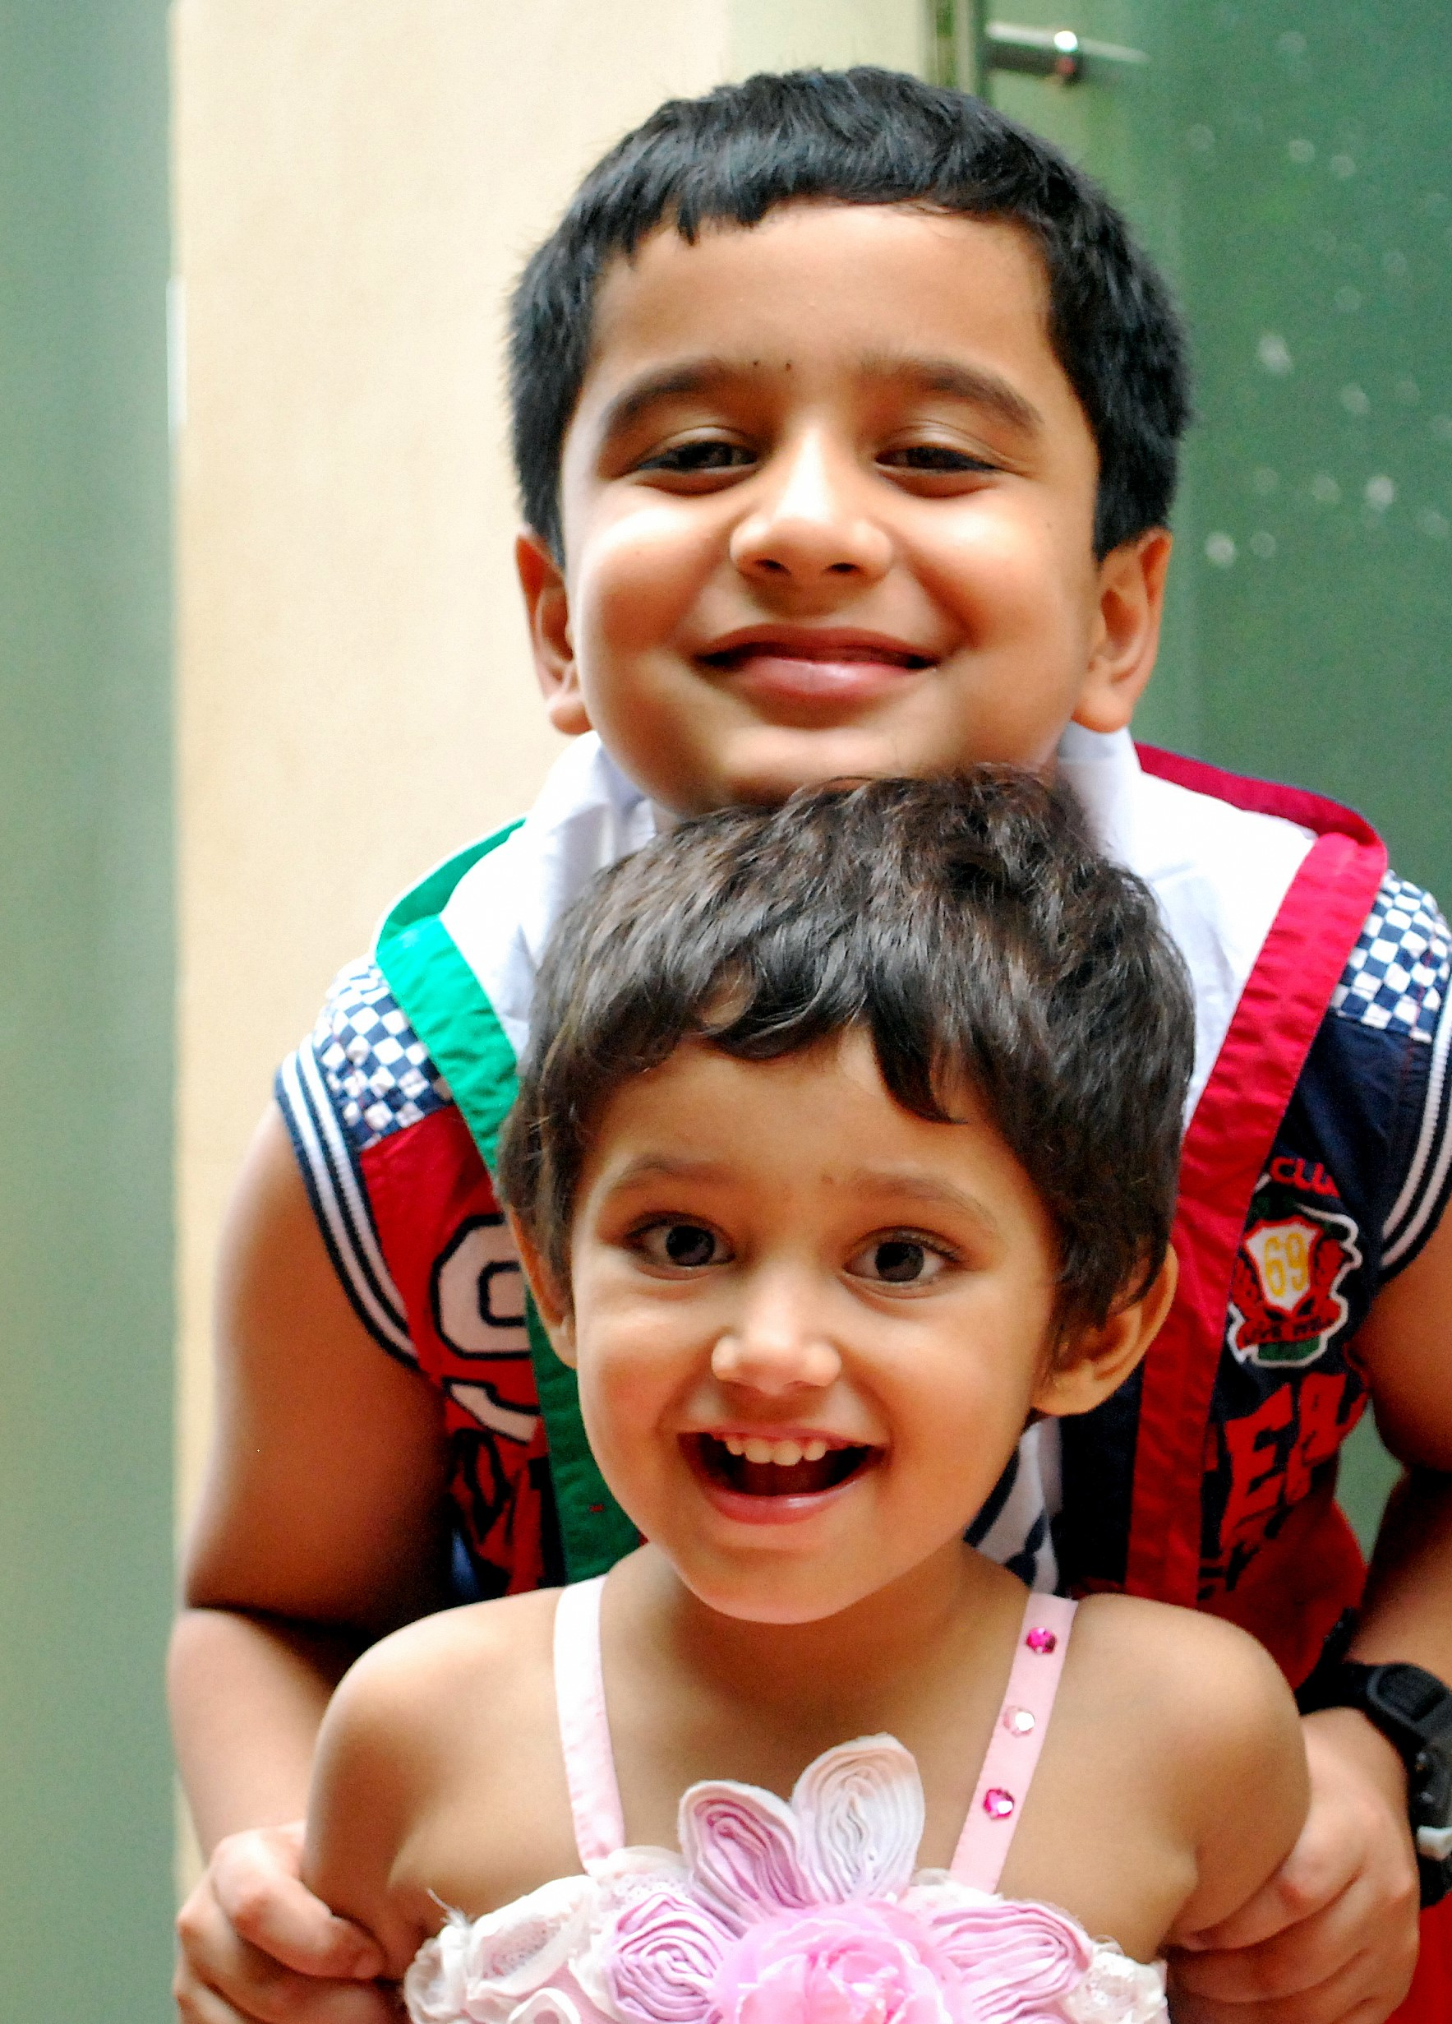
Project name
CHILD ADOPTION SYSTEM

Slide 3
TEAM MEMBER ROLES AND RESPONSIBILITIES
210930920016 | Sandip Muralidhar Golekar
210930920018 | Bhushan Bhausaheb Gunjal
210930920024​ | Snehal Jagdish Mahale​
210930920030 | Hrishikesh Natha Nalavade

Slide 4
INTRODUCTION: What the Project & why this project?
This project is to provide online help to the orphanage so that they could help the orphan children and people who want to adopt children. People who want to adopt any child can contact online and the admin will confirm the time of visit to the orphanage house to see the child or they can see the child's information on the website after registration.
These children in the national building by providing care, support, and protection in our CHILD ADOPTION SYSTEM. The project proposed in this scheme is meant for providing additional support to the child by adopting.

Slide 5
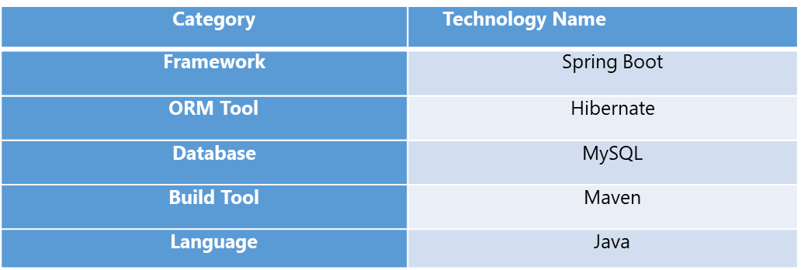
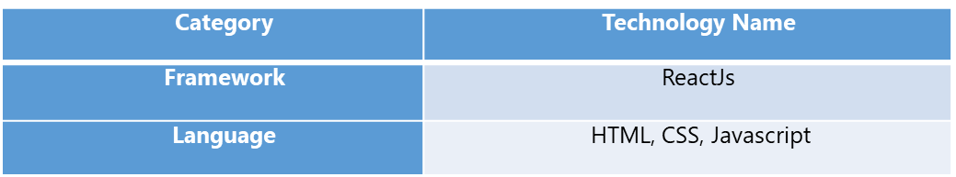
PROJECT TECHNOLOGY STACK
Backend Technologies:
Frontend Technologies:

Slide 6
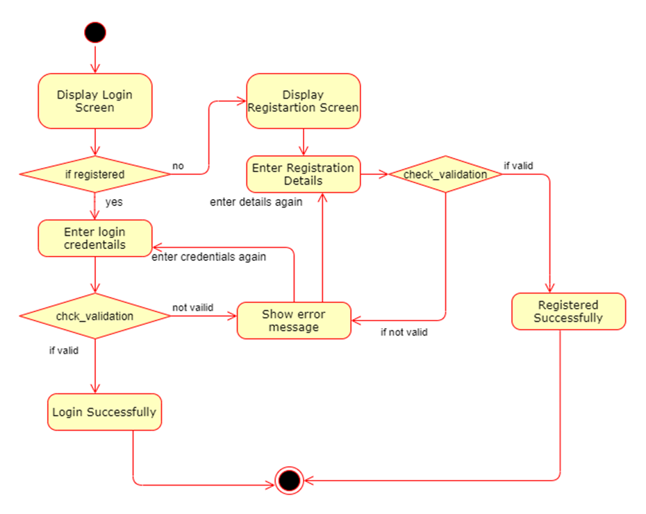
PROJECT FLOW DIAGRAM: LOGIN Diagram
Login flow and Registration flow Dia

Slide 7
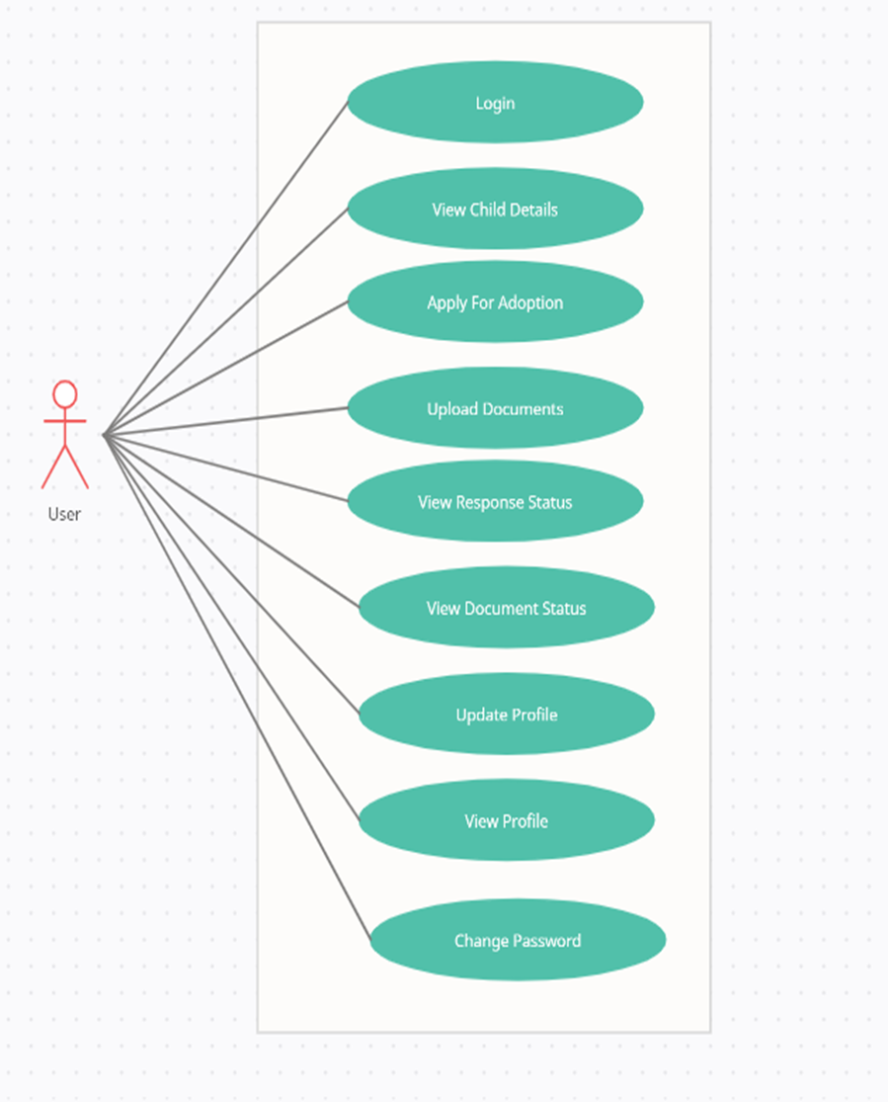
PROJECT FLOW DIAGRAM: User Case Diagram

Slide 8
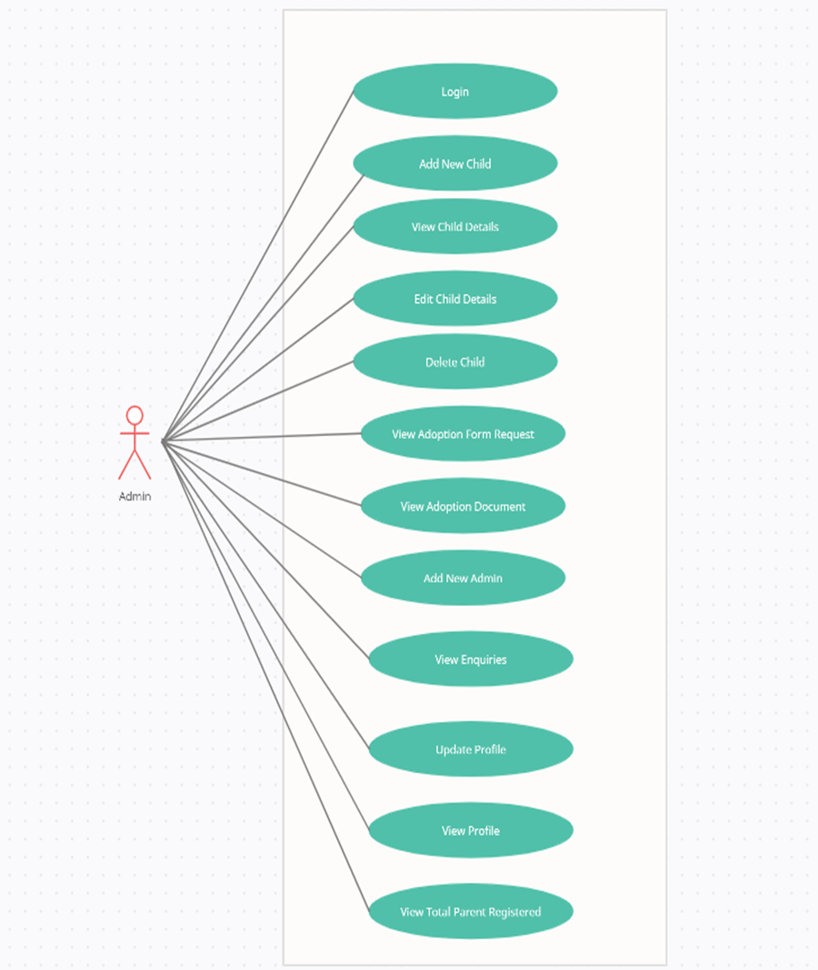
PROJECT FLOW DIAGRAM: Admin Case Diagram

Slide 9
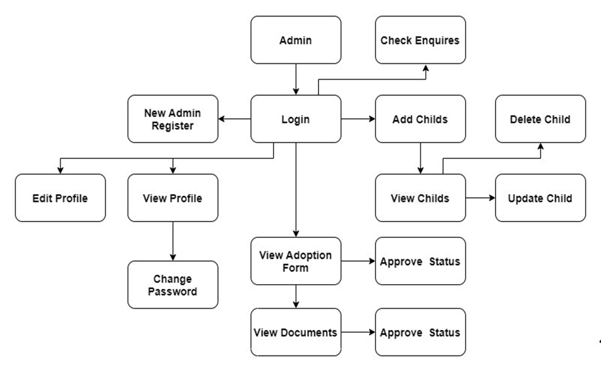
PROJECT FLOW DIAGRAM: Admin Data Flow (DFD)

Slide 10
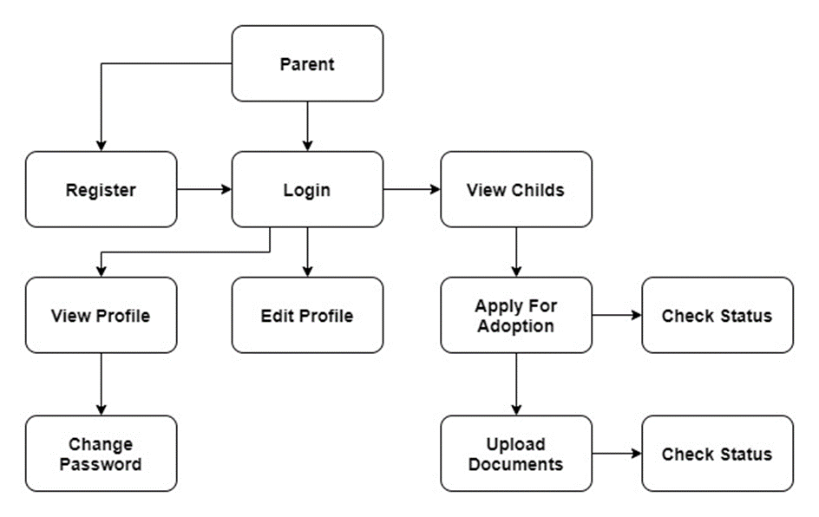
PROJECT FLOW DIAGRAM: Parent/User Data Flow (DFD)

Slide 11
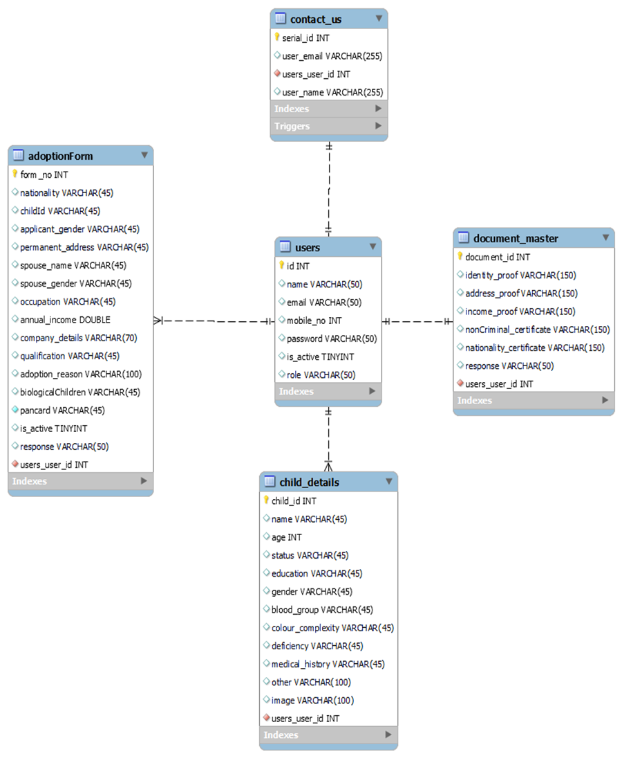
PROJECT FLOW DIAGRAM: E-R Diagram

Slide 12
Future Scope
App Development
Implementation to provide care, support and protection for orphans.

Slide 13
Thank you !

